Slide 1
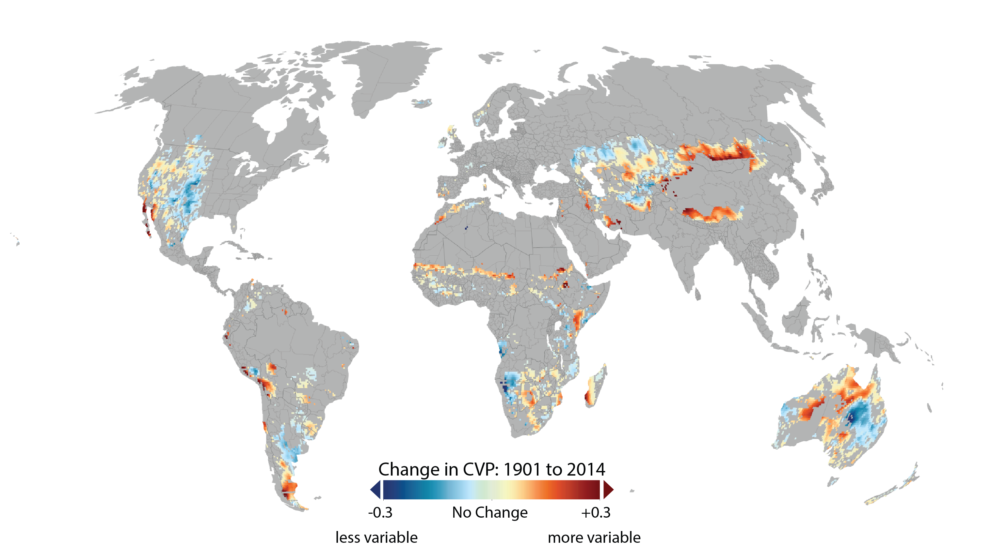
Notes:
Changes in precipitation variability on global grazing lands over the last century measured as the between-year coefficient of variation of precipitation (CVP). Increases in CVP, especially in arid grazing lands, may lead to increased risk to livestock production. However, CVP trends should be interpreted with caution, as the actual changes in risk depend on the starting conditions and on-the-ground realities.

