Slide 1
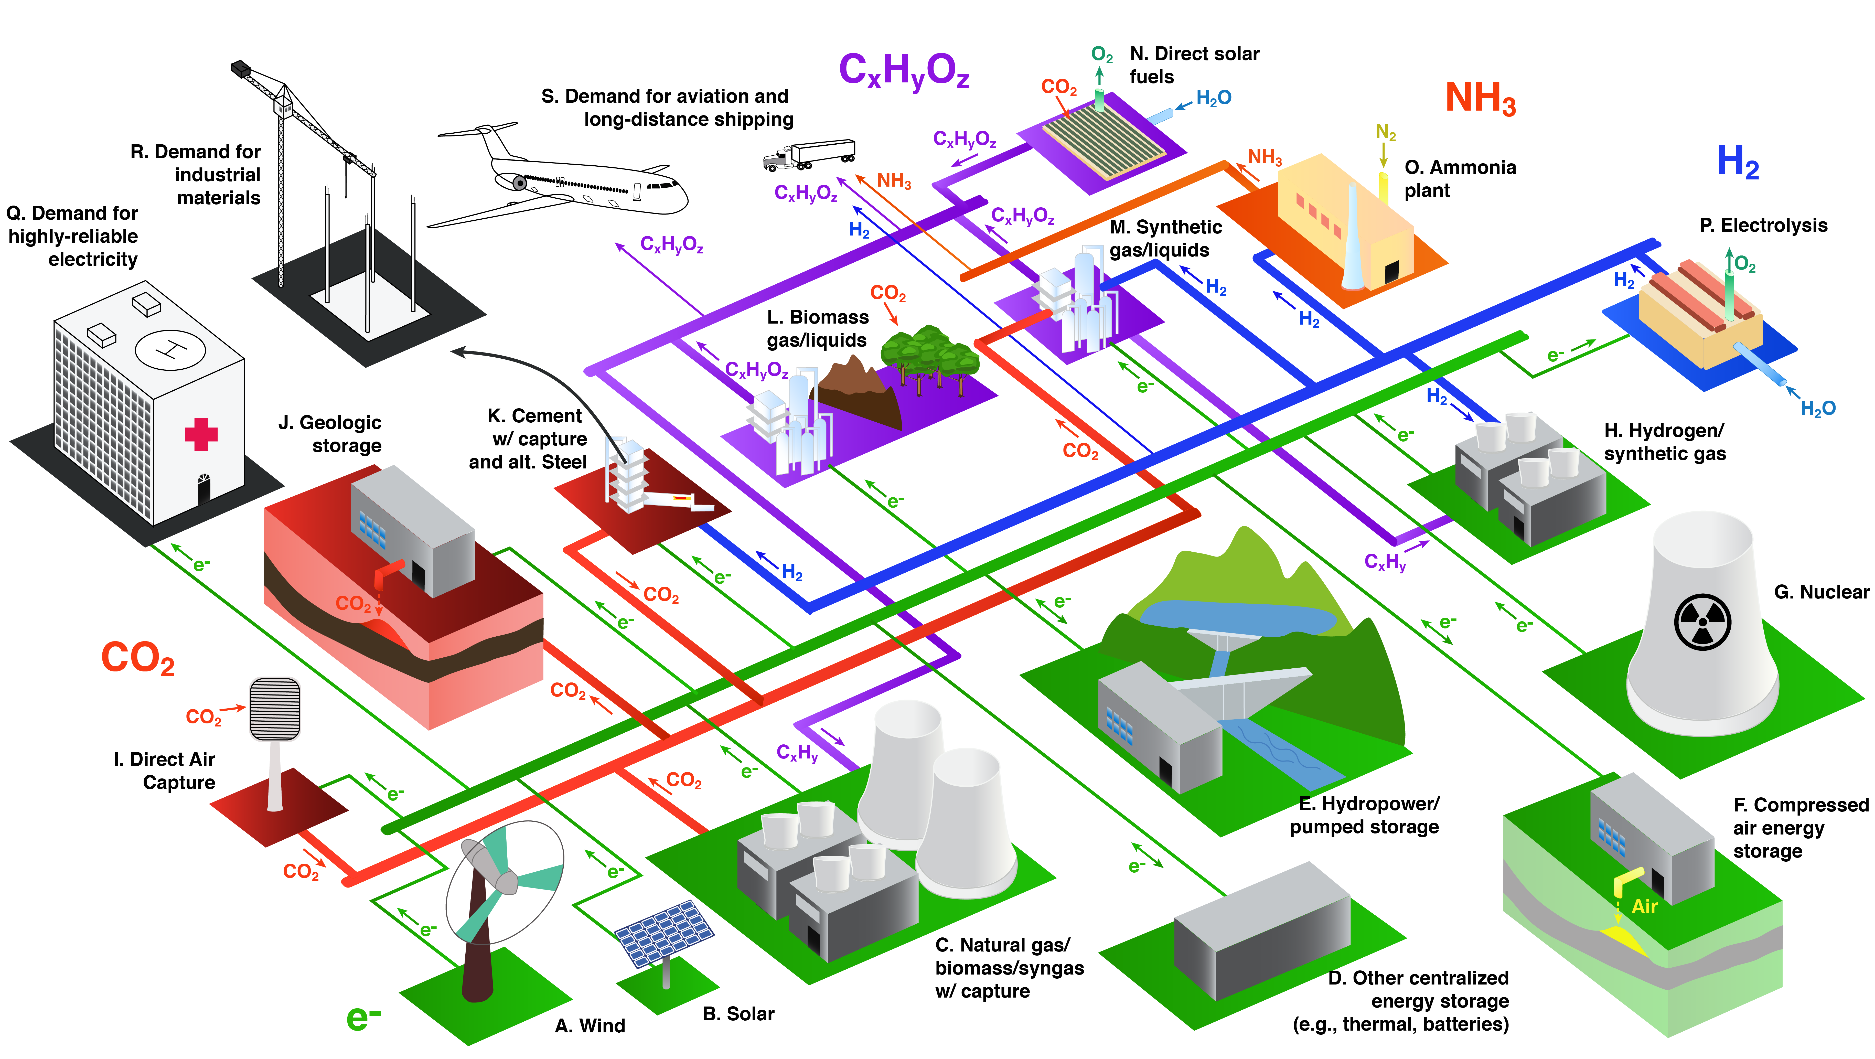
Schematic of an integrated system that can provide essential energy services without adding any CO₂ to the atmosphere.
Davis et al., Science, 2018
Notes:
Colors indicate the dominant role of specific technologies and processes. Green, electricity generation and transmission; blue, hydrogen production and transport; purple, hydrocarbon production and transport; orange, ammonia production and transport; red, carbon management; and black, end uses of energy and materials.

