Slide 1
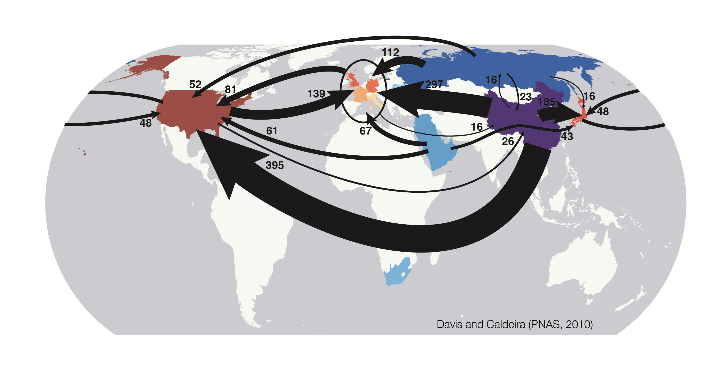
Consumption-based accounting of CO₂ emissions
Mt CO₂ emissions embodied in international trade in 2004, from net exporters (blues) to net importers (reds)

