Slide 1
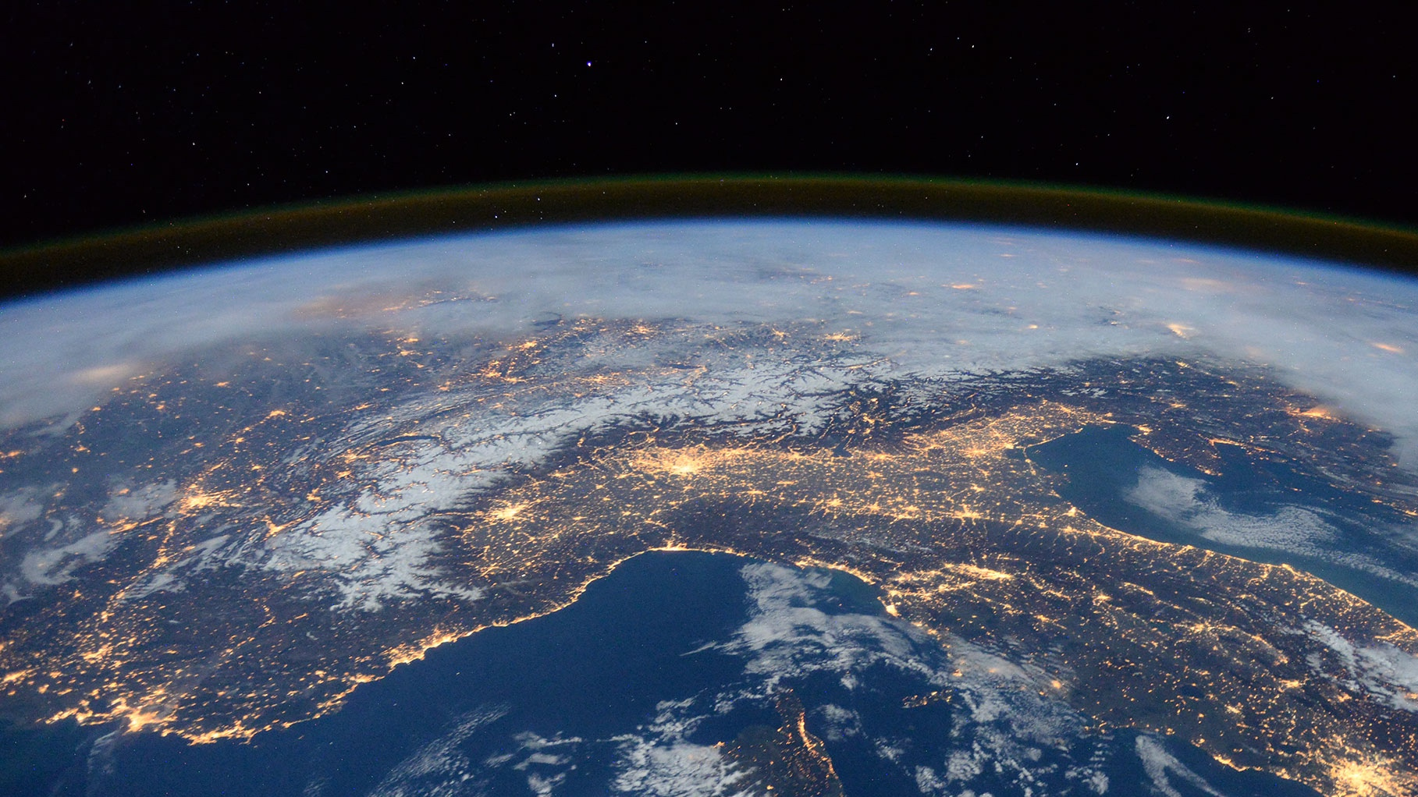
Environmental Science and Policy
at UC Irvine
October 27^{th,} 2020
Notes:
Welcome, we are super excited to have the opportunity to tell you all about our program and answer any questions you may have. Etc. (Introduce presenter)

Slide 2
Are you passionate about climate change? Consider a career in climate change science and solutions
Notes:
Climate change is today’s most important issue that humanity is facing.
Are you considering a career in climate change and solution?
The Department of Earth System Science is the first department in the nation to train world class leaders to address our society’s mitigation efforts related to the effects of a changing climate.
You will learn about:
The CAUSES of climate change: why our carbon emissions (by burning fossil fuel or deforestation) leading to changes in temperatures
The CONSEQUENCES of climate change, such as ocean acidification, desertification, sea level rise
And explore some of the SOLUTIONS that can be put into place to mitigate these consequences

Slide 3
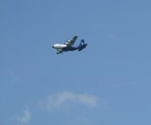
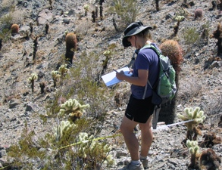
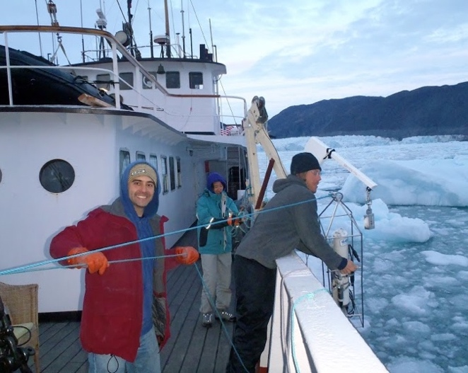
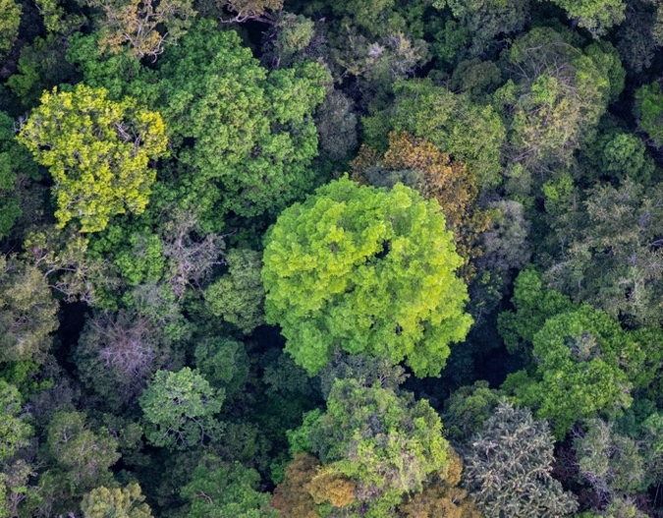
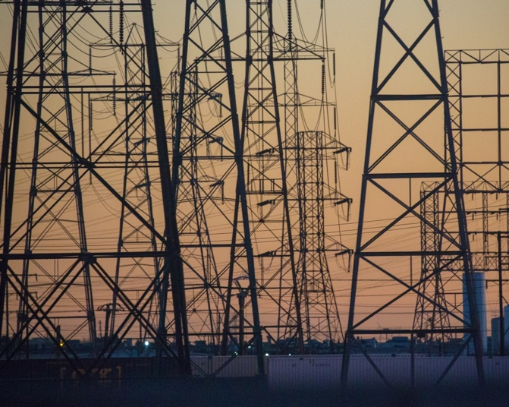
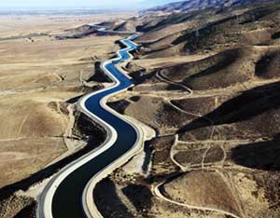
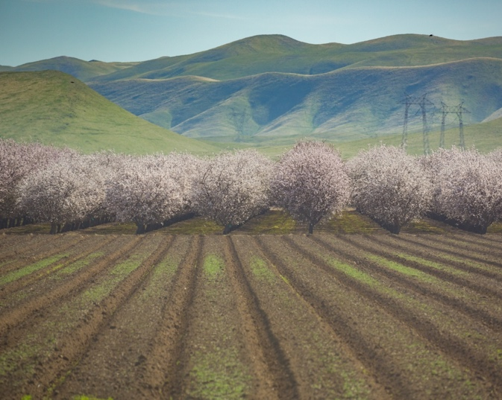
What you will learn about
Ocean
Atmosphere
Land
Biodiversity
Freshwater
Agriculture
Policy
Energy
Notes:
ESS is a highly interdisciplinary field that focuses on how the atmosphere, land, oceans, cryosphere, and life interact as a system. You will learn about many different disciplines:
The Atmosphere: not only atmospheric dynamics and weather, but also air pollution and extreme events
Land: how our ecosystems and soils respond to changes in our climate system
Oceans: sadly you are not going to learn about fish and whales, but how our oceans move at the surface and deeper and how this circulation is affects the distribution of heat and nutrients around the globe
Biodiversity and ecosystem services, deforestation etc
Energy is responsible for about 75% of total U.S. anthropogenic emissions so you will learn about alternative sources of energy
Freshwater: we are in Southern California where we don’t have a lot of water so you will learn about water rights, and the consequences of water diversion on ecosystems
Agriculture: which of course depends on local climate, but you will also learn that agriculture itself can have a strong impact on local climate!
And policy: once we know what is causing climate change, and what we can do to change the situation, policies need to be implemented, you will also learn about environment justice and injustice
By learning about all of these disciplines, you will acquire many skills that will be incredible assets once you are on the job market. You will of course use math, Physics and chemistry, but also how to use a geographic information system (GIS), how to program to analyze data, how to design statistical tests to test a hypothesis, etc. You will not necessarily be experts in any of these fields, but you will know enough about the Earth System to have a comprehensive understanding about the problems we are facing, and you will be Swiss army knives in terms of the skills you have acquired in our program.
broad range of data and scientific approaches to better understand, predict, and solve the most urgent environmental problems of our time.

Slide 4
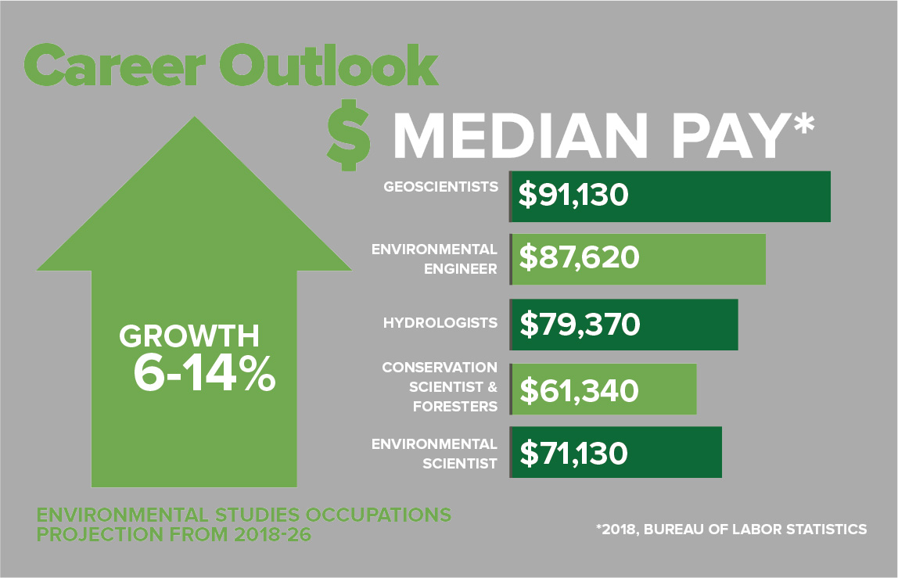
Where will you make your mark?
Industry
Environmental consulting
State/Federal Agency
Environmental Protection Agency
Air Quality
Water management
Research
National laboratories
Universities
Policy, regulation, NGOs
Economics
Public policy
Activism
Environmental advocacy group
…
Land
Notes:
The field of Earth Science is expected to grow between 6 to 14% over the next couple of years, there is a real growing demand for people with this knowledge and skills. Our graduates went on to work in the industry where … (read)

Slide 5
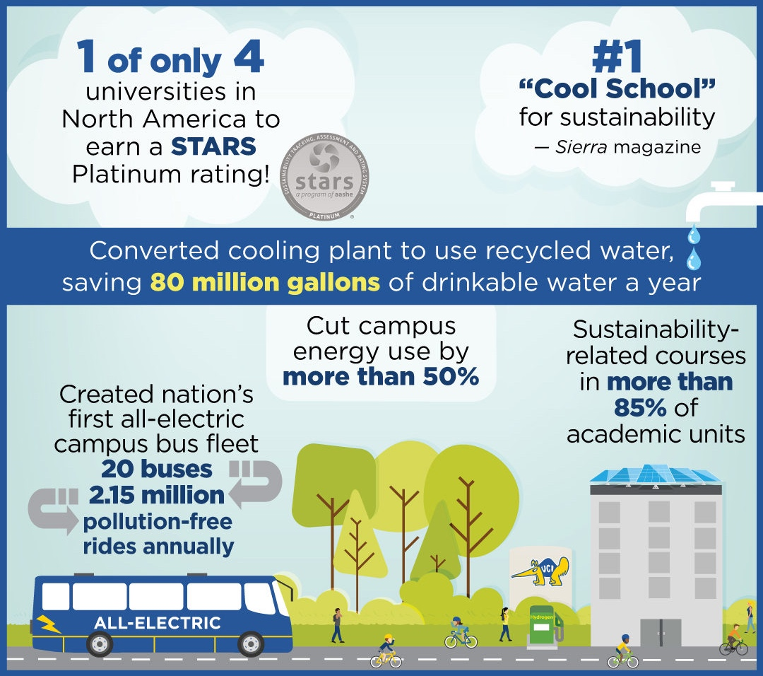
Where are we?
Sunny Southern California
Reach the beach, go desert camping, or head for the mountains
33,000 students, 1,200 faculty members
Top green university in U.S
Best-Value Education in the nation (Money Magazine, Forbes)
Ranked #9 among public universities nationwide (U.S. News & World Report)
Notes:
UCI is a fantastic home for our department because it is the most sustainable college in the U.S. and Canada. We have been in the top 10 for the past 11 years thanks to our curriculum, research, campus operations and public engagement.
We have cut our energy use by more than 50%, all of our buses are electric and we have sustainability related courses in more than 85% of the programs that UCI offers.
By joining UCI, you are joining a university system that is committed to sustainability and reducing its carbon footprint to 0.
If you don’t know where Irvine is, it is in Southern California, with absolutely gorgeous weather year-round, the beach is just 15 minutes away, you can surf and ski the same day if you want to, the desert is also an incredible place, just 1h away if you like camping.
UCI has a population of about 33000 students, 1200 faculty members, and has been steadily growing since it was founded in 1965. We have been named best-value university in the nation over the past 3 or 4 years in a row by Money Magazine and Forbes, we are ranked #9 among public universities in the US.

Slide 6
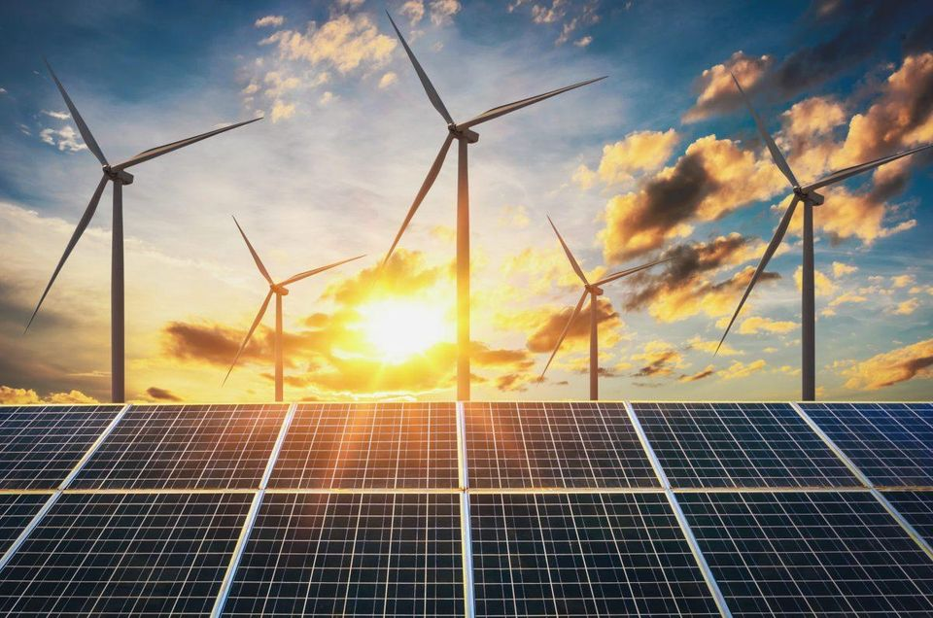
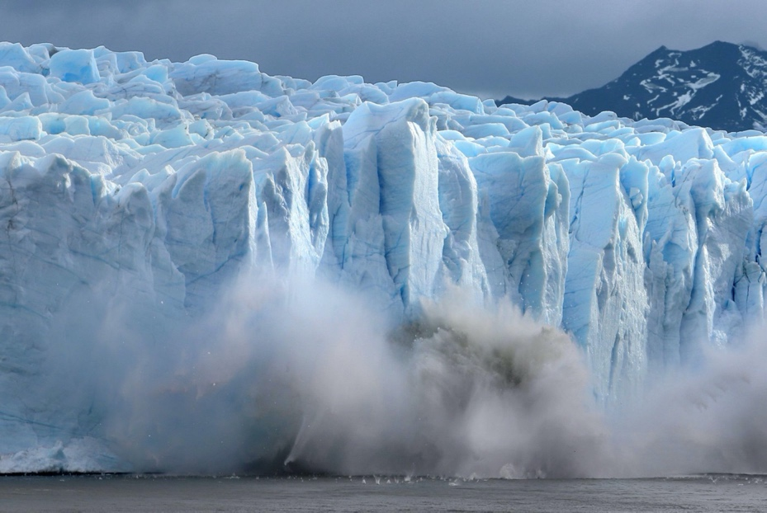
B.S. in Earth System Science | B.A. in Environmental Science & Policy | PhD in Earth System Science
Learn about the science underlying environment problems, including climate change and ecosystems, ocean acidification, atmospheric pollution, etc. Prepare for a career in science or research | Learn about how science and humans interact Prepare for careers in government, non-profit, and private industry that involve both science and policy | Work with researchers with global perspectives and broad research skills, as well as a high level of expertise in specialized areas
Double Major
Notes:
We offer 2 majors, 1 minor and 1 PhD program.
BS: you will learn about the science of climate change in general, and you will then have a career in science or research.
Our BA is in partnership with the school of Social Ecology, and you will learn about both the science and policy aspects of climate change and sustainability. You will do a career in government, non-profit and private industry
We also have a minor in Earth and Atmospheric sciences
We also offer a PhD program for people who want to do a career in research or academia, which provides many research opportunities to our undergraduate students.
One thing to note is that many of our students double major, either between ESS and ENSP or across campus.

Slide 7
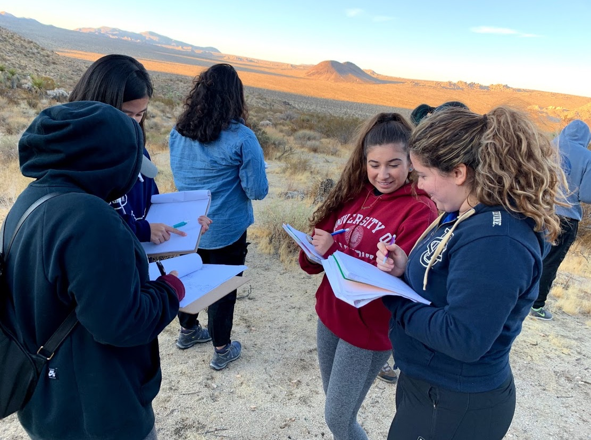
B.S. in Earth System Science
Focused on the science underlying these problems, including climate change and ecosystems, ocean acidification, atmospheric pollution, etc.
Specializations in:
Atmospheric Science
Hydrology and Terrestrial Ecosystems
Oceanography
Prepares for a career in science or research
Notes:
To give you a bit more details about our majors. In our BS, you will focus on the science of climate change and implications in terms of atmospheric pollution, ecosystems, ocean acidification etc. We offer 3 specializations for the students that want to specialize in a specific area if you have specific interests
Atmospheric science
Hydrology and Terrestrial Ecosystems
And Oceanography

Slide 8
B.A. in Environmental Science & Policy
Joint degree between ESS and the Dept. of Urban Planning and Public Policy
Includes ESS coursework covering the science of global and local environmental problems, as well as sustainable energy, agriculture, water systems, economics, law, and policy elements of environmental management.
Graduates will be prepared for careers in government, non-profit, and private industry that involve both science and policy, including research on coupled human and natural systems.
Notes:
The BA includes the science of global and local environmental problems, but also sustainable energy, agriculture, economics, law and policy elements of environmental management.
TALK ABOUT SOCIAL JUSTICE?

Slide 9
The Earth System Science PhD program
ESS is a fully-funded PhD program:
Moving allowance and recruitment fellowships available
Monthly stipend and health insurance (incl. summers)
Convenient and affordable on campus grad housing
Application details at: https://grad.uci.edu/admissions/
Application review begins December 1st
Highly recommend contacting prospective advisors
Join our active and diverse group of ~50 graduate students – frequent social, educational, and community outreach activities!
Notes:
PhD program…

Slide 10
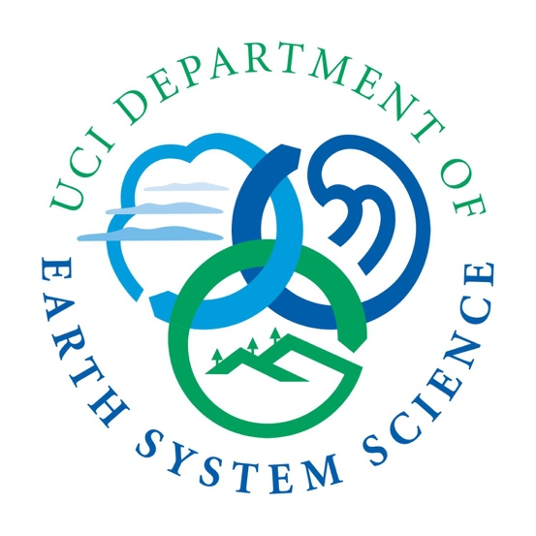
How are you going to thrive?
Small program (<50 students per cohort), which allows for:
close contact with faculty
participation in research
smaller class sizes
The ESS is one of the highest ranked departments at UCI (NRC ranked among the top 3 programs in earth sciences)
Numerous electives allow flexibility to focus on your particular interests within ESS, to pursue a double major or minor, or to branch out across campus
Many amazing opportunities: Study abroad, UCDC, Honors program, California Ecology and Conservation,…
Notes:
Our department is truly unique in many ways. We are not only the first department that has ever looked at the problem of climate change from the perspective of the Earth as a system, we have World experts that will be teaching you the science of climate change. More importantly, we are a small department and so you will get to interact with our faculty, they will get to know you, and you will have opportunities to work in their lab and do cutting edge research.
Also, we have a large number of electives so that you can design your own curriculum depending on your interests, or double major if you would like to.
You will have numerous amazing opportunities: our program being very flexible allows to participate in the UCI study abroad program, or to UCDC where you can work as interns for the white house, congress, advocacy groups etc, or the UC Natural Reserve System to do field research in protected landscapes, if you love research you can enroll in our honors program, participate in the many events organized by ESS club, etc.

Slide 11
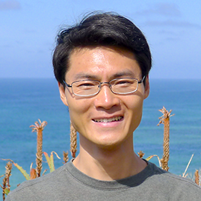
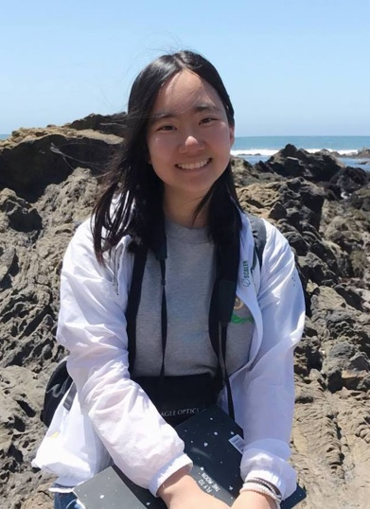
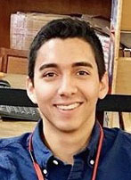
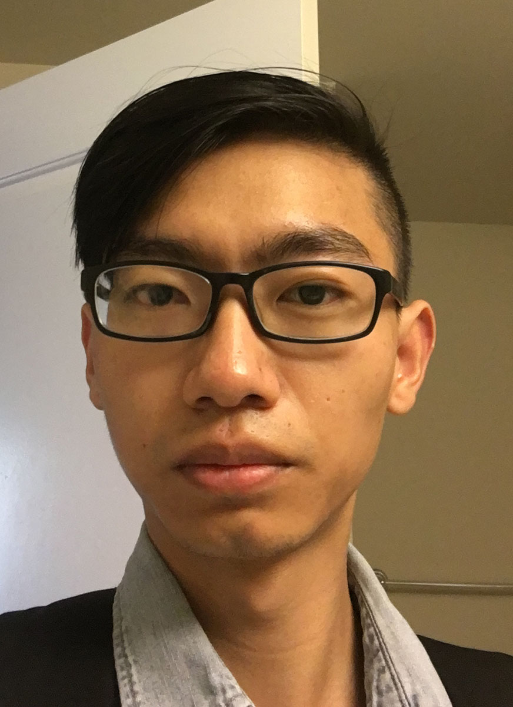
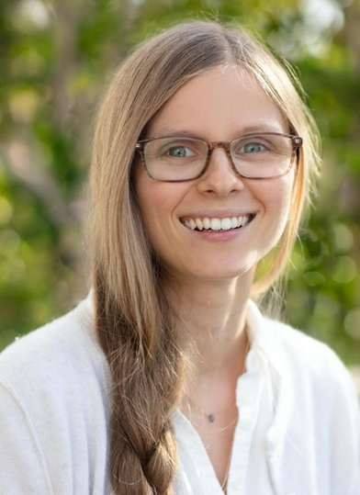
They are changing the World!
Wei Mei PhD in ESS, 2010
Professor at UNC, Chapel Hill
Alice Shen BS in ESS, 2018
data analyst for SunStreet Energy Group
Danny Macias
BS in ESS, 2017
Environmental Planner at Jacobs
Dongqian Zhang
BA in ENSP, 2016
Science Teacher at Silverado High School
McKenna Coffey BA in ENSP, 2019, Society of Environmental Journalists
Melissa Steller BS in ESS 2018
Science Technician at Cuyahoga Valley National Park
See more: https://www.ess.uci.edu/alumni-ugrad
Notes:
Our alumni go on to a wide range of careers. Undergraduate alumni go to graduate school (PhD, master, law school), work as scientific field and laboratory technicians, work on climate and environmental policy and/or science communication at non-profits and government agencies, become science teachers, etc., etc.

Slide 12
Questions?
Website: https://www.ess.uci.edu/
Instagram: @uciess
Twitter: @uciess
Facebook: UCI.ESS
Email: studentaffairs@ess.uci.edu

