Slide 1
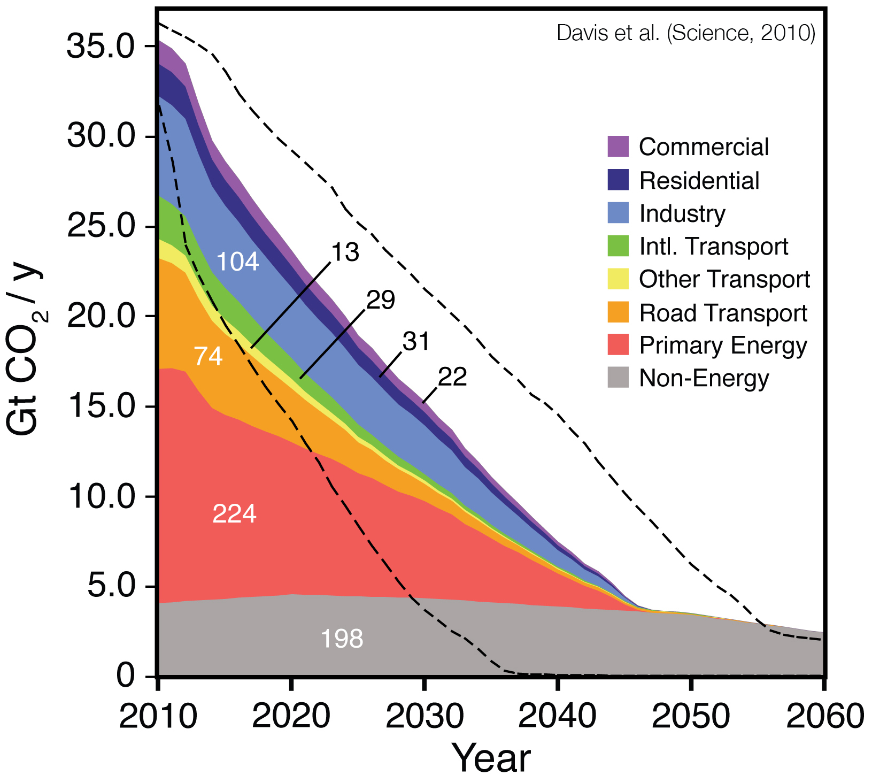
Committed CO₂ emissions - sectors
Future CO₂ emissions that can be anticipated to come from energy infrastructure existing as of 2010. Cumulative total is 494 Gt CO₂.

Slide 2
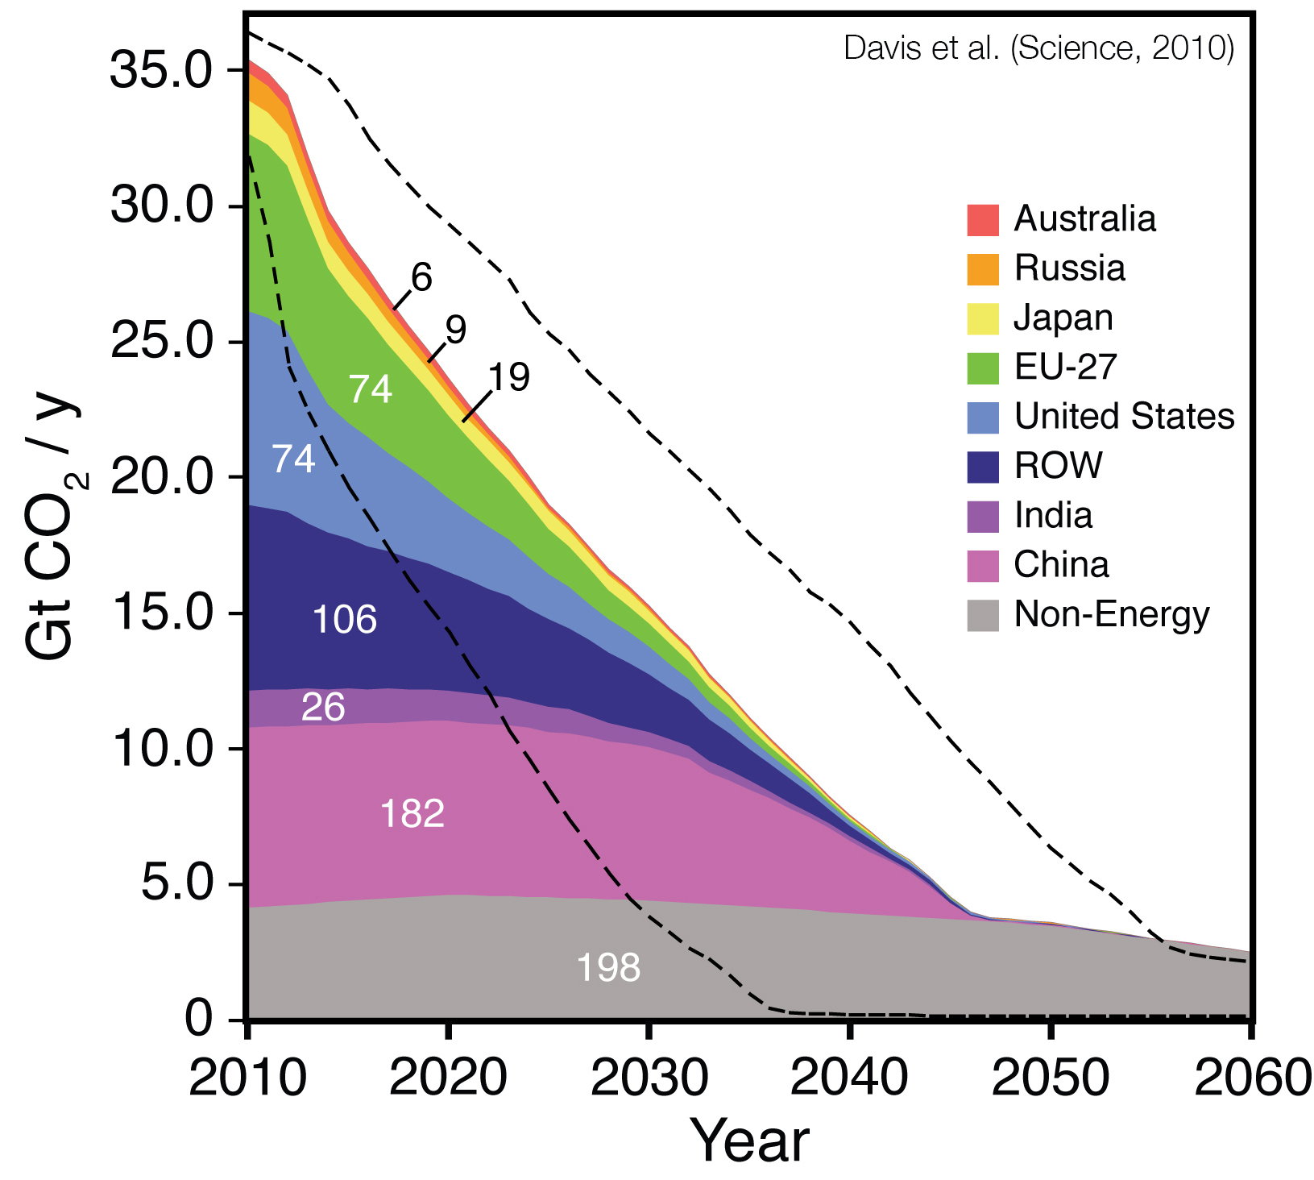
Committed CO₂ emissions - regions
Future CO₂ emissions that can be anticipated to come from energy infrastructure existing as of 2010. Cumulative total is 494 Gt CO₂.

